Slide 1
Identifying Fishing Communities for a Longitudinal Analysis of Resilience
Coefficient of Resilience, Outliers and Principal Components Analysis

Slide 2
In early 2022, SSRG sought to fill the gaps in historic dealer data. Over the course of half a year, researchers have collected and cleaned fisheries landing data from the first year of available data, 1977, to 2013.
Overall data info:
Data Sources
Dataset stitched together by Anthony Mastitski
Goal: calculate fisheries engagement and reliance indicators
to determine how important are fisheries in a community
Accumulative Landings System (ALS)
Gulf States Marine Fisheries Commission (GSMFC)
Shrimp data is extracted from NOAA-SEFSC Gulf Shrimp System.
Notes:
ALS - This data set contains year, month, state and county where landed, reporting dealer, gear used, area of catch, species landed with summary pounds and value for all ex-vessel seafood products that are landed in the SE Region of the US mainland and sold to established licensed seafood dealers and brokers. Currently, the landings are typically reported by the dealers on electronic 'trip tickets' to their State agency and from there to the regional commission databases. The data are then loaded to the ALS at the NOAA - Southeast Fisheries Science Center (SEFSC). (Data from the US Caribbean are reported by fishers and are listed separately under catalog item 20884).
These data, also referred to as the general canvass landings statistics, have been collected by the NOAA-National Marine Fisheries Service and its predecessor agency, the Bureau of Commercial Fisheries. They are available on computer since the mid 1920's. The quantities and values that are reported in this data set include monthly landings that were initiated in 1972. Between 1926 and 1971, data were collected annually and not monthly. Mixed annual and monthly data occur from 1972-1976 according to State and year. The general canvass landings include quantities and value for all commercially caught marine species and are identified by species or species group. These data are collected from or reported by every seafood dealer or broker that is licensed by each state in the Southeast Region (North Carolina through Texas). In addition, information on the gear and area of capture is available for most of the landings statistics in the data set except for Florida 1977-1996 and Louisiana 1992-1999. However, because these data are summaries, while they identify the dealer, do not contain information on the quantities of fishing effort or identifications of the fishermen or vessels that caught the fish or shellfish.
Gulf States Marine Fisheries Commission (GSMFC) – landings from 1985 to 2022 as well as recreational catch and effort data collected under NOAA MRFSS/Marine Recreational Information Program (MRIP) beginning in 1981.

Slide 3
Overall data info:
Many states have transitioned in the last few decades to the Trip Ticket program
Historic fisheries landings data has not always been digitized in the transition process
The 2022 effort sought to fill gaps in the historic dealer data
All of the data was first downloaded – each year from 1977
Later years had more info on dealer names compared to early data so this later info was used to complete the dataset when possible
Data sources used for cross-reference: The Annual Interstate Certified Shellfish Shipper’s List, state business directories, online newspaper archives
All states were contacted to collect all digitized data available before Trip Ticket data collections.
Dataset contains info on: year, state of landing, county, dealer code, species, pounds weight, ex-vessel value price (paid to the fishing vessel)

Slide 4
Trip Ticket Transition years
Florida – 1985
Louisiana - 1999
Alabama- 2000
Texas- 2007

Slide 5
Limitations and Strengths
No digitized data before the Trip Ticket program for Texas and Louisiana
Uneven data availability can influence trends
Shrimp data seems to be most reliable

Slide 6
Coefficient of Variation (CV)
In practical terms, a CV value of 100.6 indicates that the variability in the total landed fish values for that city is substantial, and the mean may not be a reliable summary measure on its own. Analysts often use the CV to assess the relative dispersion or stability of a variable, and a higher CV suggests higher relative variability.
Note: When calculating the coefficient of variation (CV) for a city, the mean (average) is computed based on the values available for that specific city across the years where data is available. It doesn't consider data from other cities or years.
A measure of relative variability
Standard deviation / mean = %
A high CV = high variation in values; mean not a good measure

Slide 7
Coefficient of Variation (CV)
Low Variability: In many cases, a CV below 10% is considered relatively low variability. This implies that the standard deviation is small compared to the mean, suggesting that the values are closely clustered around the average.
Moderate Variability: A CV between 10% and 30% is often considered moderate variability. It indicates a moderate level of dispersion around the mean.
High Variability: A CV above 30% is generally considered high variability. This suggests that the values are more spread out, and there is a substantial degree of fluctuation relative to the mean.
This is what where we need to have a conversation about how we will define high and low variability

Slide 8
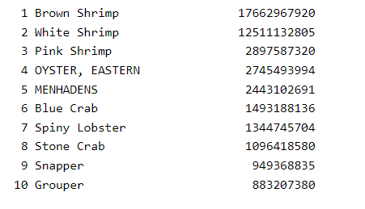
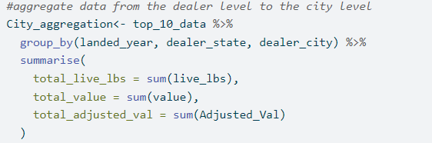
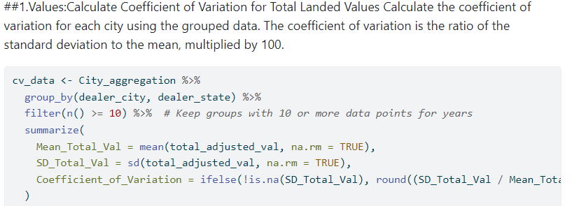
1.
➔ Menhadens were excluded from the final analysis
2.
3.
➔ This is a measure relative to the values landed in each city across 10 or more years

Slide 9
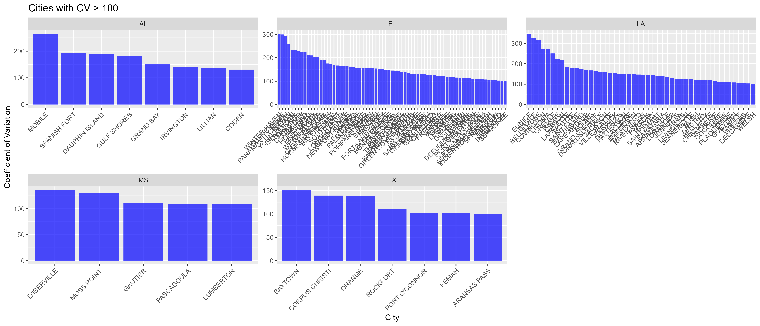

Slide 10
Values and Pounds High Variation
dealer_city | state | Mean_Total_lbs | SD_Total_lbs | CoefVar_lbs
EUNICE | LA | 62938.8947 | 243130.268 | 386.3
BASILE | LA | 79714.8824 | 274881.385 | 344.83
WINTER HAVEN | FL | 572.889091 | 1770.19998 | 309
BELLE ROSE | LA | 3010 | 8802.40788 | 292.44
SANIBEL | FL | 7707.8 | 21941.5763 | 284.67
PANAMA CITY BEACH | FL | 66544.8643 | 177602.471 | 266.89
CREOLE | LA | 148708.182 | 358331.971 | 240.96
PALATKA | FL | 6959.16667 | 16345.7597 | 234.88
GONZALES | LA | 7004.73333 | 16373.515 | 233.75
GULF BREEZE | FL | 18954 | 43967.3357 | 231.97
GRANT-VALKARIA | FL | 8543.30769 | 18210.5277 | 213.16
RAYNE | LA | 42073.6647 | 88455.5271 | 210.24
BOURG | LA | 141334.148 | 294408.968 | 208.31
WEWAHITCHKA | FL | 77861.366 | 159216.934 | 204.49
COCOA | FL | 64799.5294 | 130232.575 | 200.98
MOBILE | AL | 156124.556 | 299103.731 | 191.58
GRAND BAY | AL | 86957.2083 | 157719.277 | 181.38
SPANISH FORT | AL | 38238.8571 | 67591.6146 | 176.76
INGLIS | FL | 167226.303 | 293266.152 | 175.37
LONGBOAT KEY | FL | 97050.075 | 169901.553 | 175.07
ARNAUDVILLE | LA | 5380.8 | 9319.56283 | 173.2
GIBSON | LA | 39994.2857 | 67881.0677 | 169.73
GHEENS | LA | 85200.8421 | 144157.524 | 169.2
PLAQUEMINE | LA | 7278 | 12176.3965 | 167.3
HARVEY | LA | 108840.796 | 181033.52 | 166.33
Community | State | Mean_Total_Val | SD_Total_Val | Coefficient_of_Variation
EUNICE | LA | 72399.1053 | 252087.617 | 348.19
BASILE | LA | 125733.647 | 412601.689 | 328.16
BELLE ROSE | LA | 10814.8125 | 34297.7732 | 317.14
WINTER HAVEN | FL | 846.363636 | 2564.44623 | 303
GULF BREEZE | FL | 80906.6552 | 242270.057 | 299.44
PANAMA CITY BEACH | FL | 247290.543 | 726082.454 | 293.62
COVINGTON | LA | 72371.85 | 197259.631 | 272.56
LIVONIA | LA | 11079 | 30062.7768 | 271.35
MOBILE | AL | 395128.639 | 1049743.59 | 265.67
MILTON | FL | 253905.205 | 652724.644 | 257.07
CREOLE | LA | 145057.136 | 363706.289 | 250.73
YOUNGSTOWN | FL | 2692803.79 | 6290863.83 | 233.62
ISLAMORADA | FL | 1762935.3 | 4118248.76 | 233.6
ORLANDO | FL | 440465.407 | 1007109.07 | 228.65
CROSS CITY | FL | 3183344.8 | 7192276.04 | 225.93
RAYNE | LA | 66649.4211 | 149948.724 | 224.98
BAGDAD | FL | 167335.13 | 375526.104 | 224.42
GIBSON | LA | 63820.1905 | 138709.56 | 217.34
HOMESTEAD | FL | 46225.9231 | 97421.4841 | 210.75

Slide 11
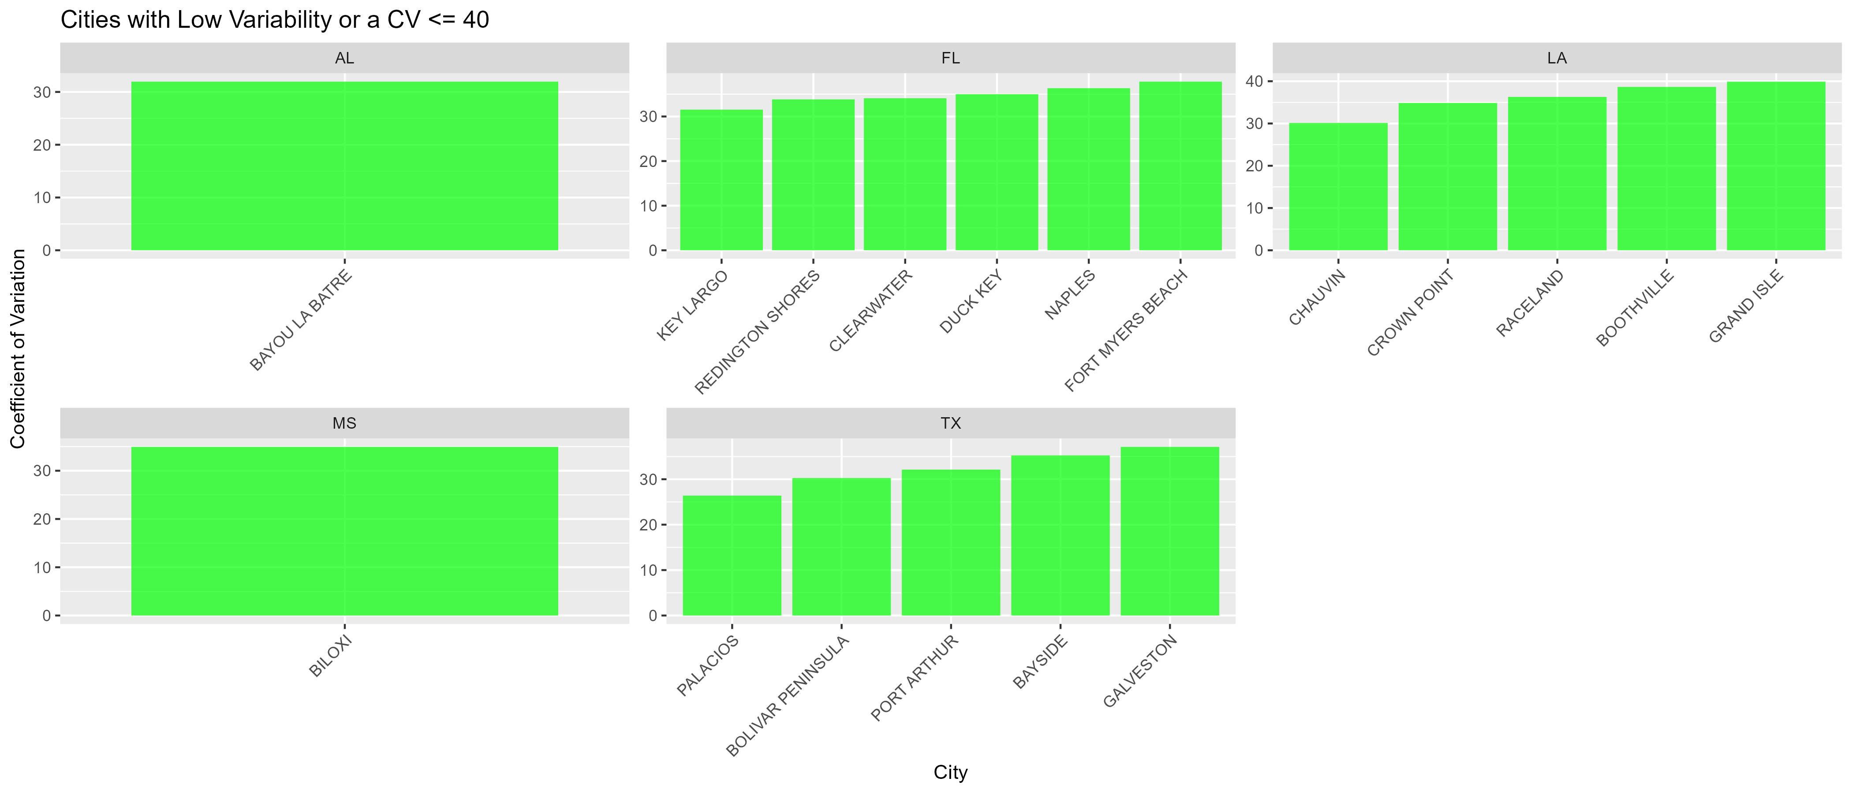
Values and Pounds Low Variation
dealer_city | dealer_state | Mean_Total_lbs | SD_Total_lbs | CoefVar_lbs
BAYOU LA BATRE | AL | 12781775.4 | 3558673.23 | 27.84
BAYSIDE | TX | 947.9 | 259.430766 | 27.37
KEY LARGO | FL | 387220.269 | 75814.8278 | 19.58
dealer_city | dealer_state | Mean_Total_Val | SD_Total_Val | Coefficient_of_Variation
GRAND ISLE | LA | 13212030.8 | 5271799.63 | 39.9
BOOTHVILLE | LA | 7983917.86 | 3086165.17 | 38.65
FORT MYERS BEACH | FL | 14820950.9 | 5604211.51 | 37.81
GALVESTON | TX | 14856877.8 | 5514270.71 | 37.12
NAPLES | FL | 2573032.32 | 935058.081 | 36.34
RACELAND | LA | 1321041.05 | 479388.177 | 36.29
BAYSIDE | TX | 1152.1 | 406.161284 | 35.25
DUCK KEY | FL | 917949.7 | 321299.687 | 35
BILOXI | MS | 21724962.8 | 7589952.84 | 34.94
CROWN POINT | LA | 4855115.13 | 1691959.87 | 34.85
CLEARWATER | FL | 975877.429 | 332634.015 | 34.09
REDINGTON SHORES | FL | 1246979.75 | 421816.06 | 33.83
PORT ARTHUR | TX | 42274703.2 | 13580711 | 32.12
BAYOU LA BATRE | AL | 44324629.7 | 14163557.9 | 31.95
KEY LARGO | FL | 2185388.41 | 689151.974 | 31.53
BOLIVAR PENINSULA | TX | 16433040 | 4973069.87 | 30.26
CHAUVIN | LA | 15854400.8 | 4778718.88 | 30.14
PALACIOS | TX | 36234069.1 | 9561976.82 | 26.39

